Slide 1



LOAN DATA ANALYSIS USING MICROSOFT EXCEL (2021 – 2022)
Odunayo Oyeyemi
Loan Analysis Overview

Slide 2
CONTENTS
Introduction/Overview
Problem Statement
Data Cleaning and Transformation
Data Analysis
Loan Analysis Dashboard
Key Insights and Recommendation
Limitations
Conclusion

Slide 3
INTRODUCTION/OVERVIEW
This project focuses on creating a Loan Data Analysis Dashboard for The Data Immersed (TDI), a financial services company specializing in providing loans to individuals and small businesses. The dashboard will offer insights into loan performance, customer demographics, and key risk factors, enabling TDI’s management to make informed, data-driven decisions about loan approval processes, interest rates, and risk management. The goal is to enhance risk mitigation, optimize loan approvals, and improve overall customer satisfaction.
Loan Analysis Overview

Slide 4
PROBLEM STATEMENT
TDI faces challenges in managing its loan portfolio due to high default rates, difficulties in understanding borrower risk profiles, and optimizing interest rates across different customer segments. The Loan Data Analysis Dashboard aims to address these issues by analyzing key metrics such as loan performance, customer demographics, and loan risk factors, providing actionable insights that will enable TDI to improve its loan approval processes, mitigate risks, and enhance profitability.
Loan Analysis Overview

Slide 5




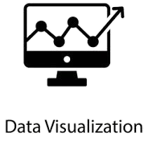
METHODOLOGY
Step 1
Step 2
Step 3
Step 4
Step 5
Data Collection
Data Understanding
Data Cleaning
Data Analysis and Insights
Data Visuals and Recommendations
Loan Analysis Overview

Slide 6
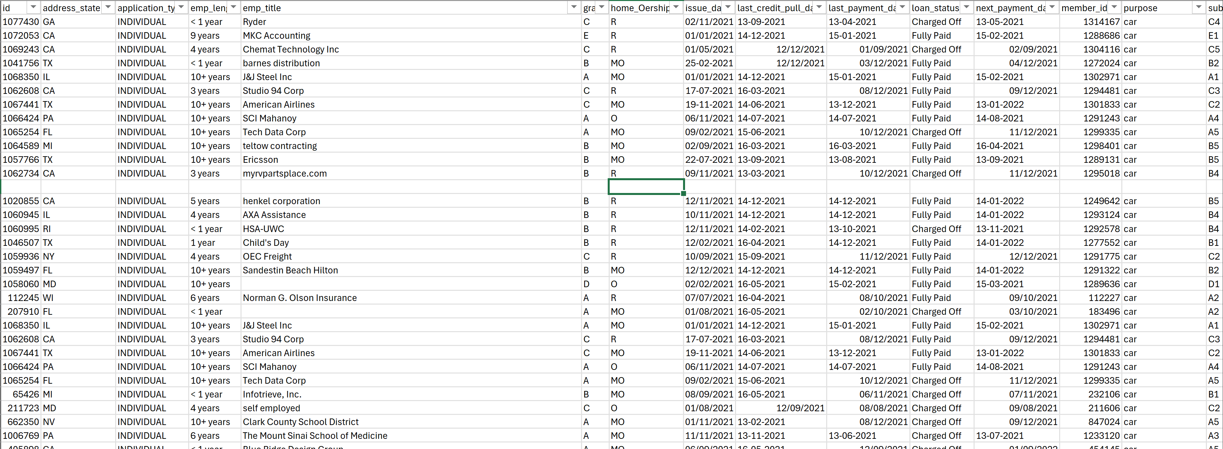
AN UNCLEANED DATA
Loan Analysis Overview

Slide 7
DATA CLEANING AND TRANSFORMATION
The dataset was imported into Excel and underwent extensive cleaning and transformation to ensure accuracy.
Steps Included:
* Remove Duplicates by using the appropriate formular, Sort & Filter.
Sorted out the columns header accordingly and applied the necessary format to the table, i.e trim, proper, upper, lower and using text to columns.
Applied the Currency Symbol on Column T, V and X.
Used the Find and Replace formular to correct most of the errors while doing data formatting.
Applied Conditional Formatting so as to give it a standard excel sheet.
These steps were essential for improving the quality of the data and enabling accurate analysis.
Loan Analysis Overview

Slide 8
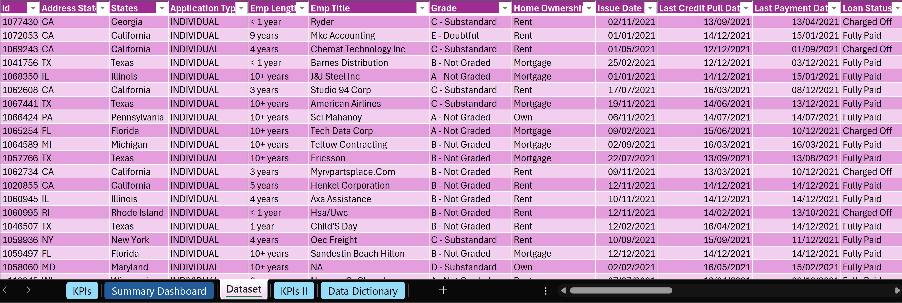
A CLEANED DATA

Slide 9
DATA ANALYSIS
The analysis of the cleaned dataset focused on the key metrics to derive insights into loan performance and customer demographics.
The following analyses were conducted:
*Loan Default Rates: Analyzed default rates segmented by customer demographics such as income and emp. Length and identifying patterns in risk.
*Impact of Interest Rates: Assessed the relationship between interest rates and loan performance, revealing trends in borrower behaviour based on varifying interest levels.
*Loan Amount Distribution: Evaluated loan amounts across different customer segments and purposes, helping to understand customer needs and preferences.
*Approval rates: Examined loan approval rates by region and customer risk profiles, providing insights for improving the loan approval process.
Loan Analysis Overview

Slide 10
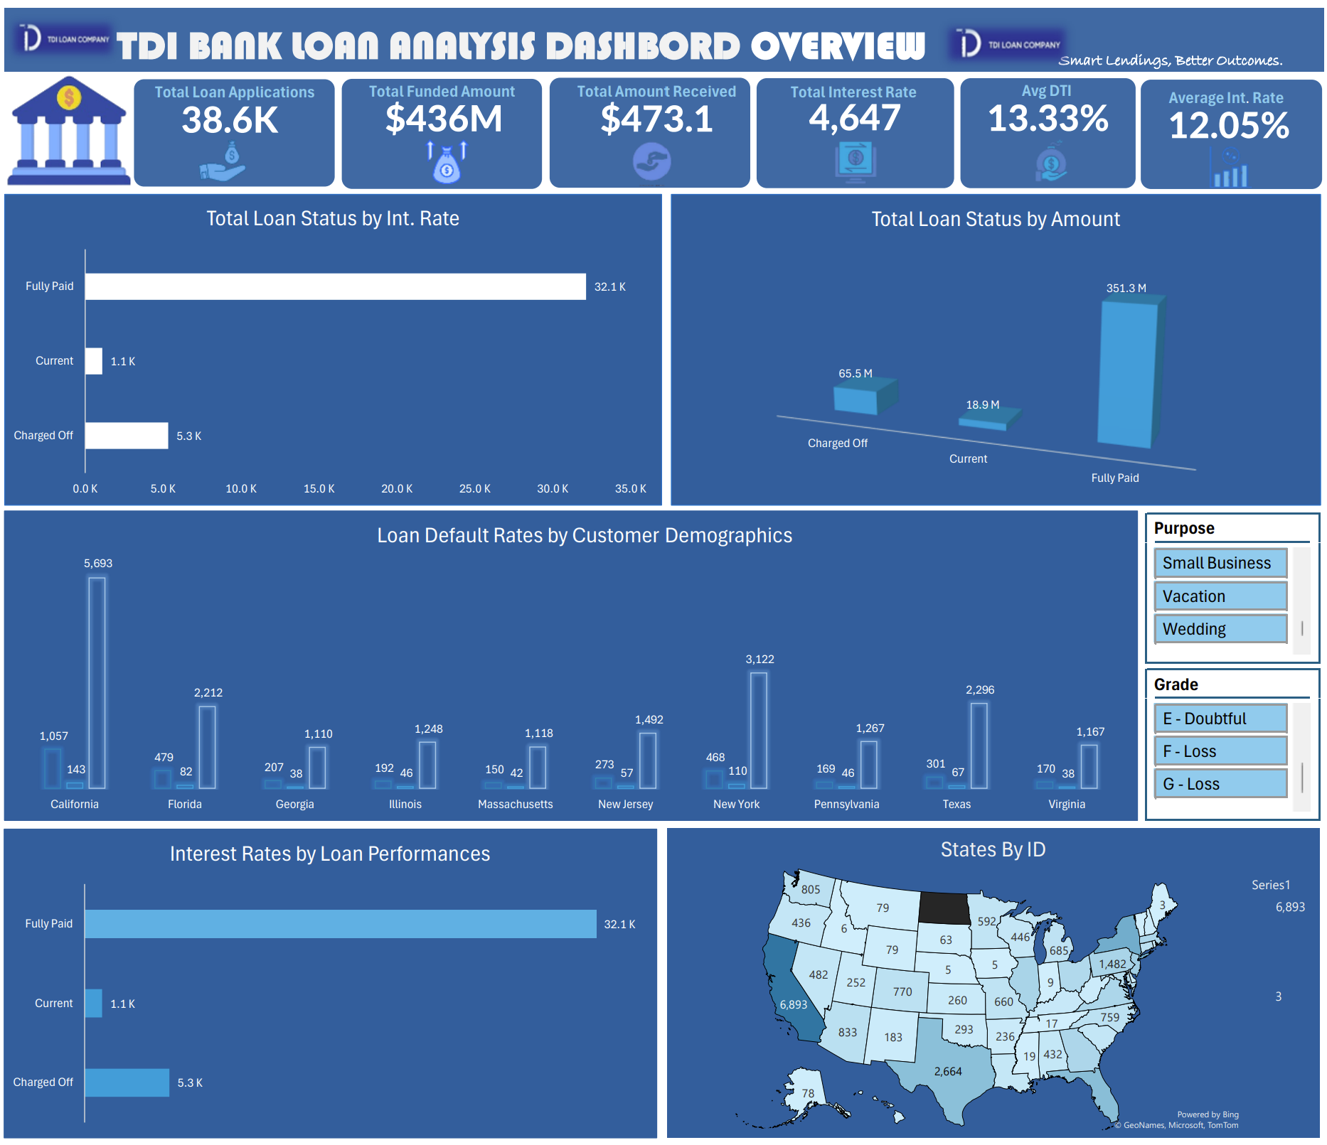
DATA VISUALIZATION
The Loan Data Analysis Dashboard was designed to present key insights through interactive visuals elements, enhancing the understanding of loan performance. Key features include:
*Visual Elements: Utilized bar charts, line graphs, histograms, and pivot charts to represent data visually, making trends and patterns easily identifiable.
*Slicers: Enabled filters by Grade and loan purpose to allow management to drill down into specific data segments.
Loan Analysis Overview

Slide 11
KEY INSIGHTS/RECOMMENDATIONS
Enhance Risk Management: Implement stricter loan criteria based on credit scores and debt-to-income ratios to minimize default rates.
Interest Rate Adjustment: Align interest rates with borrower risk profiles to strike a balance between attracting customers and minimizing defaults.
Targeted Customer Segmentation: Offer tailored loan packages to specific demographics, particularly high income, low-risk borrowers, to boost profitability.
Improve Data-Driven Decision Making: Leverage the insights from the Loan Data Analysis Dashboard to continuously monitor loan performance and make informed decisions about loan approval, risk mitigation and profitability.
Loan Analysis Overview

Slide 12
LIMITATIONS
Incomplete Data: Missing values, especially in fields like total debt and monthly income, may affect the accuracy of the analysis.
Data Quality Issues: Inconsistent data entries in fields such as employment length and titles required extensive cleaning and standardization.
Limited Historical Data: The dataset may not fully reflect long-term trends, limiting the ability to forecast future loan performance accurately.
External Factors: Economic conditions and market trends that impact loan performance are not captured in the dataset, which may skew the analysis
Loan Analysis Overview

Slide 13




MEET OUR TEAM
Odunayo O. Oyeyemi
Donald​
Jacob
Annie
Data Analyst
DA Community Manager
Vice President
President
Loan Analysis Overview

Slide 14
CONCLUSION
The Data Analysis provides valuable insights into TDI’s loan performance, highlighting key risk factors such as high default rates in specific customer demographics and the impact of interest rates on loan repayment.
By leveraging these insights, TDI can refine its loan approval process, mitigate risks, and optimize profitability, ensuring more informed and data-driven decision-making for long-term growth.
Loan Analysis Overview

Slide 15

Odunayo O. Oyeyemi​
odunayooyeyemi1@gmail.com
www.tdataimmersed.com
Loan Analysis Overview

